Slide 1
Sonic Sentiments
Sentiment Analyzer for Music
Group 5: Lynn Nguyen, Justin Wright, Oliver von Mizener
Data Analytics Boot Camp - Project 4 Presentation
Notes:
Lynn to present
Today we are sharing our Music Sentiment Analyzer, called Sonic Sentiments, that analyzes and visualizes musical trends through genre analysis and sentiment.

Slide 2
Examine music sentiment and genre trends using a dataset of modern music up to 2019.
Analysis Goal
Notes:
Lynn to present
For our analysis, our goal is to examine music sentiment and genre trends of modern music. We hoped to have found a dataset up to our current date, but due to constraints in certain datasets we found, went with one that went up to 2019. Still modern enough though.

Slide 3
Demonstrate a proof of concept for sentiment and genre analysis of music lyrics.
Build an interactive dashboard that visualizes these trends over time.
Incorporate real-time user-submitted data via a Flask application to enhance the analysis of music trends.
Project Goal
Notes:
Lynn to present
Our goal of our project was to demonstrate proof of concept for sentiment and genre analysis of music lyrics (will show demo later), build an interactive dashboard to visualize trends over time, and incorporate real-time user submitted data to enhance analysis of music trends.

Slide 4
Raw data collection and performed cleaning and preprocessing (e.g., extracting release years, normalizing text).
Applied sentiment analysis and genre prediction using machine learning models and TextBlob.
Developed a Dash dashboard for visualizing the processed data alongside the sentiment and genre analysis.
Created a separate Flask app to gather user submissions, which are integrated into the dashboard for continuous analysis.
Our Approach
Notes:
Lynn to present
Our process began with collecting datasets to ensure it met our requirements that we needed in a dataset, then performed cleaningand preprocessing, which included extracting release years and normalizing text.
We then applied sentiment analysis and genre prediction using machine learning models and TextBlob
After our analysis was applied, we created a dashboard using Dash to help visualize the processed data alongside the sentiment and genre analysis
Created a separate Flask app to gather use submissions, which were then integrated into our dashboard for continued analysis
This approach allowed us to identify both the potential insights and limitations of our dataset, setting the stage for future enhancements with more robust, comprehensive data sources.

Slide 5
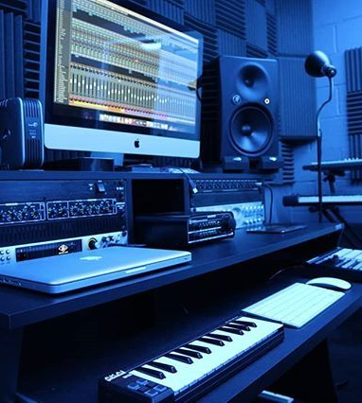
Rationale & Tool Functions
Understand music trends and evolving sentiments in lyrics
Support music marketing, playlist curation, and industry insights
Enable deeper insights into audience mood and genre classification
Potential Impact:
Improved decision-making for music producers/marketers
Basis for more advanced research integrating real-time user data
Notes:
Justin to present

Slide 6
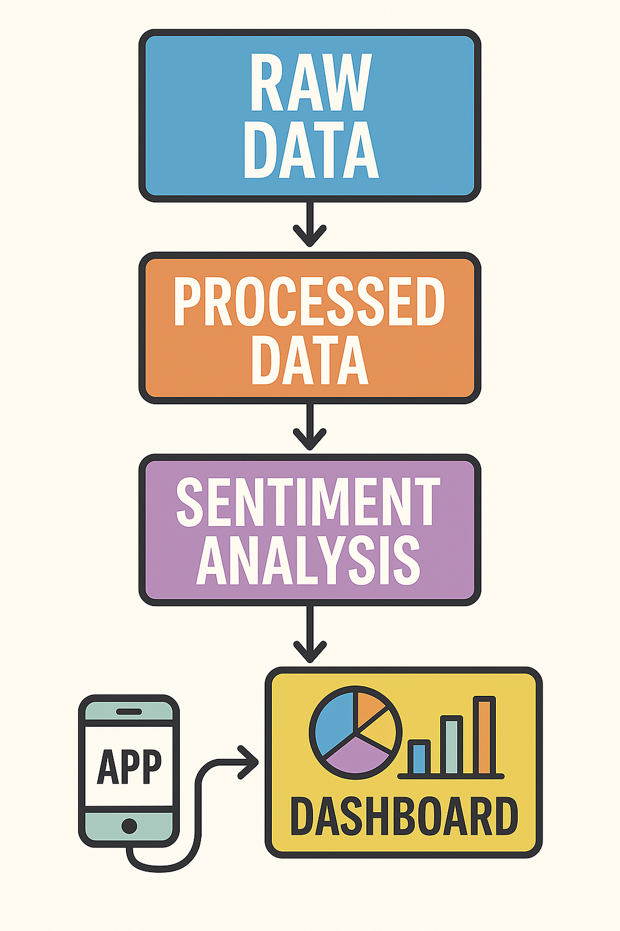
Data Pipeline
Our team envisioned a pipeline where we could take the raw CSV data to train a model.
We wanted a dashboard that could accept inputs from both the trained data and processed information, as well as user input data that compares against our original model.
This let us answer “What if” questions, and fill in the gaps from our dataset.
Notes:
Justin to present

Slide 7

Data Source
The base CSV, processed_tcc_ceds_music.csv, serves as the foundation for our analysis pipeline. This dataset includes key metadata and quantitative measures essential for both sentiment analysis and genre classification. Some of the main headers in the CSV are:
release_date: The original release dates of the tracks (used to extract the release year).
artist_name & track_name: Identifiers for each song.
genre: The genre classification for each track.
Audio Features: Including columns such as danceability, loudness, acousticness, instrumentalness, valence, and energy, which capture key sonic characteristics.
Thematic Descriptors: Columns like dating, violence, world/life, night/time, shake the audience, family/gospel, romantic, communication, obscene, music, movement/places, light/visual perceptions, family/spiritual, like/girls, sadness, and feelings that provide deeper context on lyrical themes.
This well-structured dataset, despite its limitations (such as covering data only up to 2019), allows us to cleanly transform raw music data into actionable insights for our proof-of-concept dashboard.
Notes:
Justin to present

Slide 8
Data Filtering
Standardization:
Converted all lyrics to lowercase to ensure uniformity.
Removal of Unwanted Characters:
Utilized regular expressions to strip punctuation and special characters from the lyrics.
Whitespace Trimming:
Removed extra spaces to facilitate accurate tokenization.
Outcome:
These steps produced a clean, standardized dataset that improved the accuracy of our sentiment and genre analysis.
Notes:
Justin to present

Slide 9
Machine Learning - Sentiment Analysis Model
We leveraged classical machine learning techniques using TF-IDF to vectorize lyrics for our baseline sentiment and genre analysis. This was leveraged for simplicity of execution on local hardware as well as due to dataset limitations to ensure a functional model for project submission.
We leveraged deep learning with Random Forest Regression for musical features in testing as our expanded wish-list testing.
Pre-trained models (stored as pickle files) were used for sentiment and genre classification.
Why This Approach:
The dataset's limited size and scope made conventional methods more practical and interpretable for a proof-of-concept.
Our predictive models were pre-trained and stored as pickle files, which allowed us to quickly deploy sentiment and genre analysis without the overhead of training complex deep learning models.
In future iterations—with access to larger, more comprehensive datasets—we might explore the benefits of ensemble methods like Deep Learning with Random Forest for all data points to improve accuracy and robustness. But due to limitations of the data set, we opted to ensure accuracy for sentiment and only experiment with other options for extra data points.
Notes:
Oliver to present

Slide 10
DEMO
Notes:
Oliver to present

Slide 11
Limitations/Concessions
Dataset Limitations:
Extends only to 2019 with limited genre coverage and fewer data points on specific categories than ideal.
Impact on Analysis:
May produce inaccuracies (e.g., Midwest Emo misclassified as Reggae) due to insufficient data variety. The accuracy rating on this reflects the problems with having such a narrow dataset for this.
Concessions & Future Steps:
Used the dataset as a proof-of-concept under time constraints.
Future work would involve integrating professional APIs and merging additional datasets for more robust analysis.
Running training models on cloud servers would allow for rapid testing and adjustment of deep learning models for better data insights.
Notes:
> Our chosen dataset is a significant bottleneck for the overall effectiveness of this project. We encountered considerable challenges in finding data that was both rich in meaningful features and relevant to modern music trends. The dataset we settled on only extends to 2019, covers a limited range of genres, and contains fewer entries than ideally required. Due to time constraints, we used this dataset as a proof-of-concept to conduct basic sentiment and genre analysis. However, its limitations have introduced inaccuracies—for example, some analyses may misclassify certain genres (e.g., midwest emo being read as reggae) because of a lack of sufficient comparative data. With additional time, we would incorporate professional APIs and paid services to merge multiple datasets for a more comprehensive and precise analysis.

Slide 12
Key Takeaways
Lyrics show clear sentiment patterns over time, with mainstream genres consistently leaning positive—highlighting how emotional tone aligns with commercial music trends.
Our sentiment model performed reliably using just lyrics, hitting 87% accuracy. This confirms that even simple NLP techniques are effective for capturing mood in song text.
The real-time lyric submission feature makes analysis interactive, offering immediate feedback on sentiment, genre, and musical traits—useful for artists, marketers, or fans exploring lyrical content.
Notes:
Lynn to present

Slide 13
Who can use this?
Data Analysts working at music streaming services or labels
Use Case: find trends and create actionable insights that will help inform future business decisions, either for the service or label.
Upcoming music producers
Use Case: help them find their audience, sound, and brand as they analyze their own music lyrics to better understand audience reception and current emotional trends.
Music Marketers
Use Case: help marketers better understand current and past trends and create actionable insights for future music marketing campaigns.
Notes:
Lynn to present

Slide 14
Thank you!

